Slide 1

Analytical investigation into the presence of ‘winter crises’ and the impact of Covid-19 within the NHS acute hospital sector between 2018 and 2023
Fergus Cherry
Lesley Duff
James Pritchard
Calum Young
Notes:
Public Health Scotland is the national public health body for Scotland
1 April 2020 as Scotland's leading national agency for improving and protecting the health and well-being of all of Scotland's people. PHS also took over the functions of NHS Scotland's Information Services Division, providing statistics and data analysis

Slide 2
Study questions:
1. To what extent are the ‘winter crises’ reported by the media real?
2. How has the Covid-19 pandemic affected provision of acute care in Scotland?
Temporal - when
Geographical - where
Demographic - who
Notes:
Is it getting better or worse?
Where should efforts be focussed?
Who should be targeted with efforts?

Slide 3
Key Performance Indicators (KPI)
When:
Waiting times in Accident and Emergency departments (A&E)
How many times do people ‘stay’ and the length of time of stays
Bed occupancy: staffing levels and department specialty
Where:
Health Board
Who:
Demographics: Age, Sex and Deprivation - Scottish Index of Multiple Deprivation (SIMD)
Notes:
NHSScotland consists of 14 regional NHS Boards
SIMD: If an area is identified as
‘deprived’, this can relate to people having a low income but it can also mean
fewer resources or opportunities. SIMD looks at the extent to which an area is deprived across seven domains: income, employment, education, health, access to services, crime and housing.

Slide 4
App

Slide 5
Crisis? What Crisis?
Common topic in newspaper headlines:
“NHS Scotland crisis: Top medics warn Scotland to prepare for worst NHS winter on record” - The Scotsman
“A&E crisis fears as NHS ‘too busy with strikes to prepare for winter’” - The Independent
“CHILLING FRONT NHS facing ‘worst winter ever’ as strikes, Covid, flu and record wait lists pile on pressure” - The Sun
Notes:
Is there a genuine worsening during winter? Hand over to Callum who will discuss Waiting times

Slide 6
Waiting times
Data sourced from PHS
KPI examined was number of episodes of waiting times within four periods
Within 4 hours
Over 4 hours
Over 8 hours
Over 12 hours
Data was plotted and statistically tested to detect differences between:
Winter and non-winter quarters
Pre-covid years and post-covid years

Slide 7
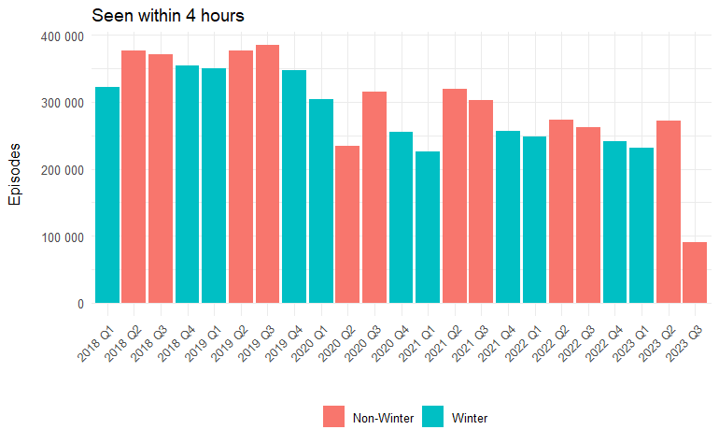
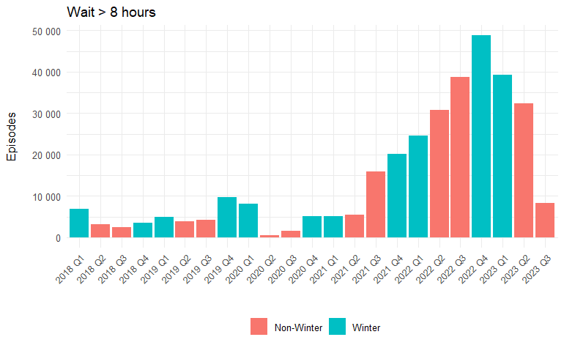
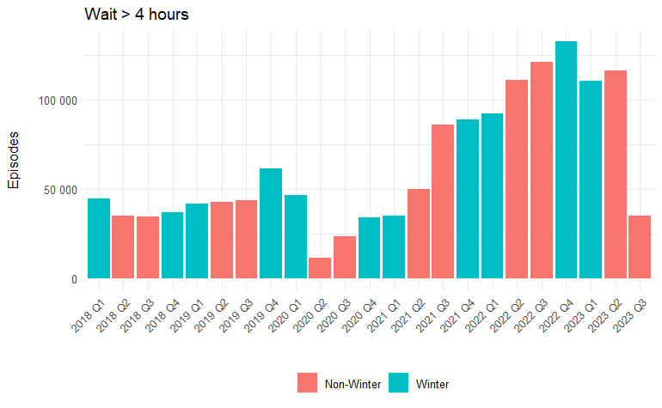
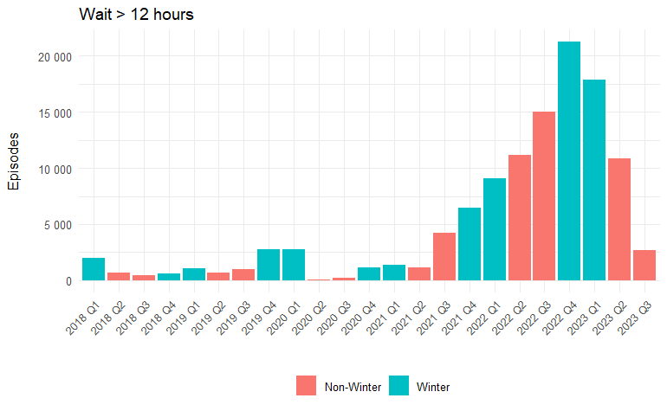

Slide 8
Waiting times Hypothesis testing
Evidence for Winter Crises in Emergency Depts.
Wait Period | P (<0.05) | Worst HB ED | Quarter | Month | Summary
Within 4 hours | < 0.05 | na | na | na | Less short waits in winter
Over 4 hours | 0.26 | Lothian (26,232/ 68,236) | Q3 2022 | Non-Winter | No difference between Qs
Over 8 hours | 0.02 | Lothian (11,898/ 70,967) | Q4 2022 | Winter | More longer waits in winter Qs
Over 12 hours | 0.002 | Lothian (6,431/ 70,967) | Q4 2022 | Winter

Slide 9
Waiting times Hypothesis testing
Evidence for Covid - 19 impacting Emergency services.
Wait Period | P (<0.05) | Max episode pre- | Max episode post- | Summary
Within 4 hours | < 0.05 | na | na | Less short waits post-covid
Over 4 hours | < 0.05 | 13,831 (Lothian Q1 2018) | 26,242 (Lothian Q3 2022) | More longer waits in post-covd
Over 8 hours | < 0.05 | 2627 (Lothian Q1 2018) | 11,898 (Lothian Q4 2022)
Over 12 hours | 0.004 | 1059 (Lothian Q1 2018) | 6431 (Lothian Q4 2022)

Slide 10
Summary
Longer waiting times in are more common in winter months
Longer waiting times are more common in post-covid Scotland
Infers waiting times KPI is negatively impacted by ‘winter crises’ and fallout remains following covid-19 to emergency services
Notes:
Hand over to Fergus

Slide 11
Bed Occupancy
No obvious difference between winter and non-winter months
Outlier in 2020 Q2 occupancy, with >3 sd difference from mean total occupancy
Difference for this quarter is due to how many beds are occupied, rather than an increase in staffed beds
Outside the scope of the report, Glasgow has an anomalous increase in accident and emergency occupancy in 2019 Q4

Slide 12
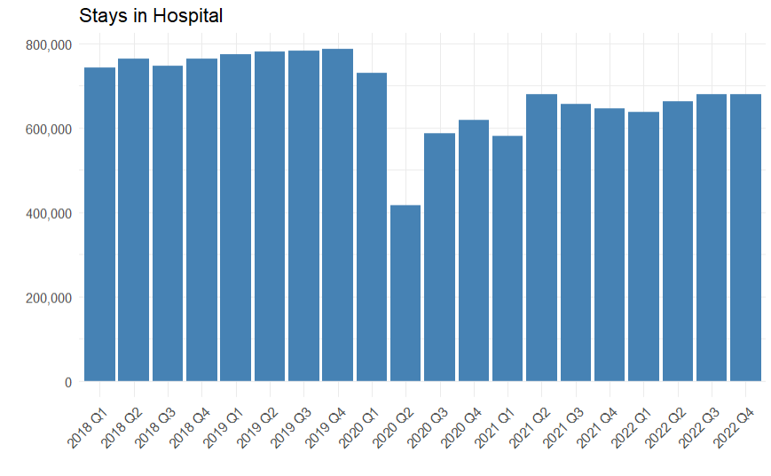
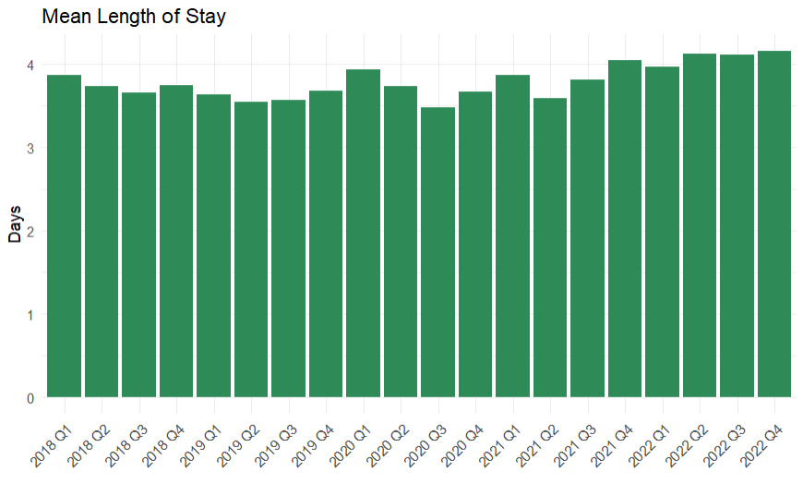
Reduction in Total “Stays” but Longer “Stays”
“Stay”: days patients spend in hospital during a continuous inpatient stay
Overall, there are significantly fewer stays in hospital post-covid.
Stays are longer, on average.
Theories:
Fewer patients presenting to hospital
Minor conditions being treated outside hospital
Barriers to managing patient flow:
COVID-19
high bed occupancy / low spare capacity
delayed discharges

Slide 13
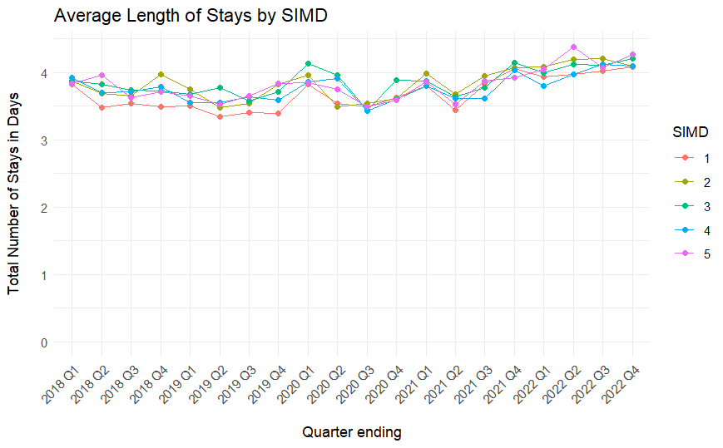
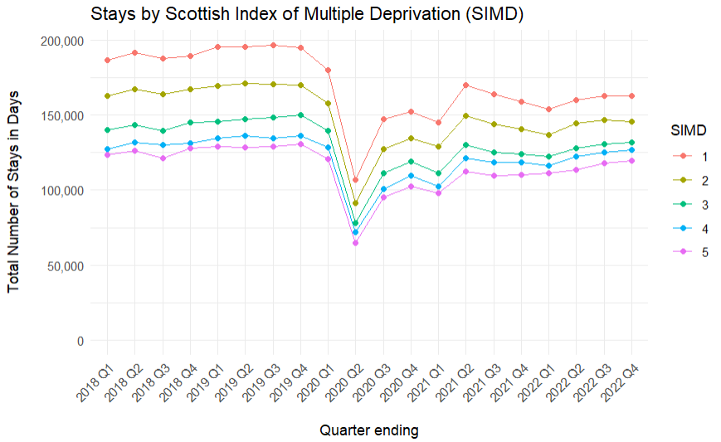
Demographics: Deprivation
Every quintile was affected by the pandemic. Post-COVID we see:
significantly fewer stays
significantly longer stays
During the COVID-19 pandemic, no SIMD quintile was affected disproportionately when considering stays in hospital
Residents of the most deprived areas of Scotland are significantly more likely to have a stay in hospital. COVID-19 has not changed this.

Slide 14
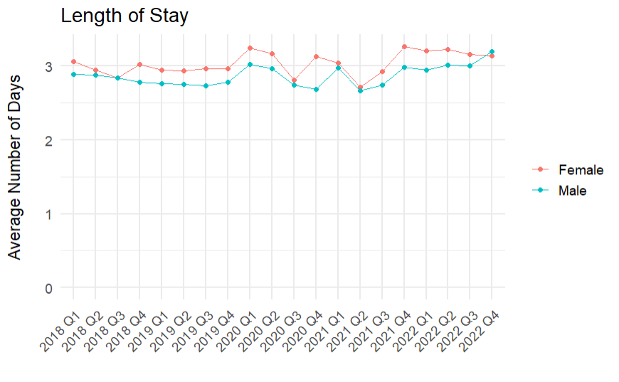
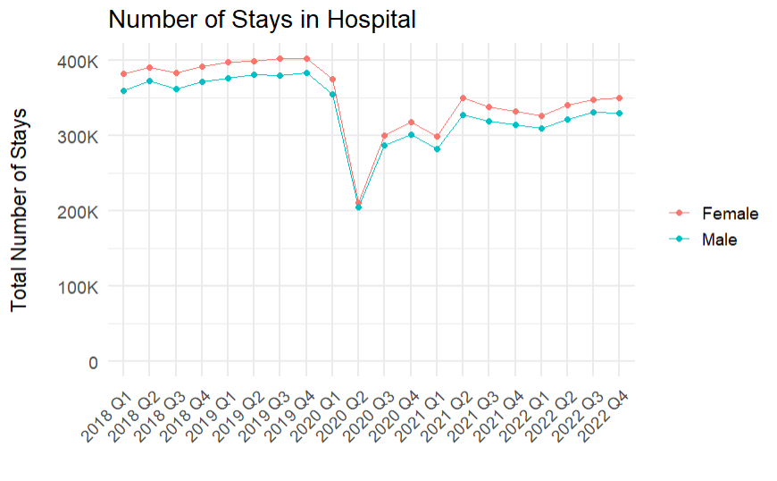
Demographics: Sex
Both sexes were affected by the pandemic. Post-COVID we see:
significantly fewer stays
significantly longer stays
During the COVID-19 pandemic, neither sex was affected disproportionately when considering stays in hospital
Women are more likely to have a stay in hospital, and are more likely to stay in for marginally longer. This may be to do with having a longer life expectancy, as well as maternity stays. COVID-19 has not changed this.

Slide 15
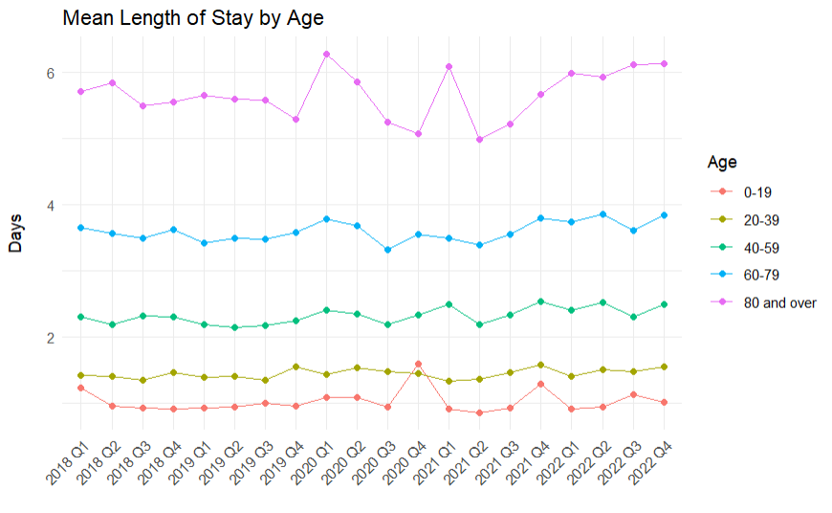
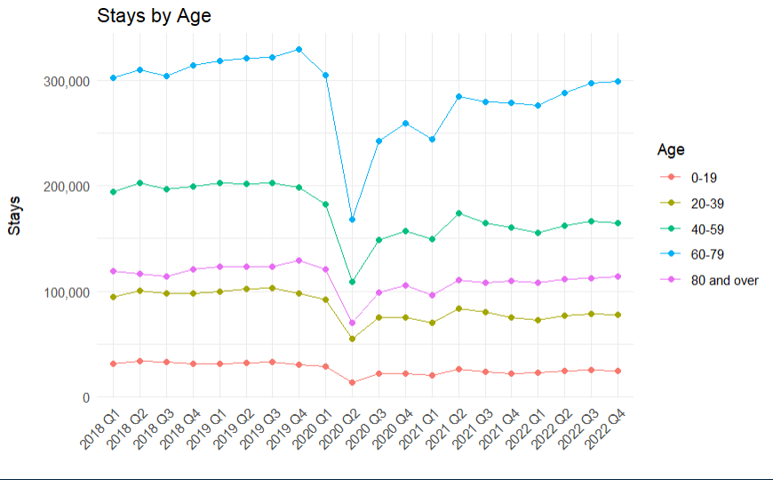
Demographics: Age
All age groups were affected by the pandemic. Post-COVID we see:
significantly fewer stays
significantly longer stays
During the COVID-19 pandemic, no age group was affected disproportionately when considering stays in hospital
The oldest age groups are more likely to have a longer stay in hospital. This is to be expected. Since the start of the pandemic, the average length of stay for people aged 80 and over has not increased significantly.

Slide 16
Summary
Number of stays in hospital has fallen post-COVID, and stays are getting longer on average. Little research available into why this is.
No demographic was significantly disproportionately affected by COVID-19. Trends that were present before persisted through the pandemic.

Slide 17
Conclusions
Is there a winter crisis?
In winter, A&E waiting times are significantly longer.
Demographics and bed occupancy do not indicate unusual activity in winter.
How has the Covid-19 pandemic affected provision of acute care in Scotland?
A&E wait times are significantly longer than before.
General increase in bed occupancy levels continues through pandemic after initial dip.
No single demographic affected more than the others.
Stays have significantly decreased across the board, but length of stay is longer.

